Slide 1
Agenda
Collections Overview
Vector, ArrayList, HashMap
Utils
Special Collections
Exercise

Slide 2
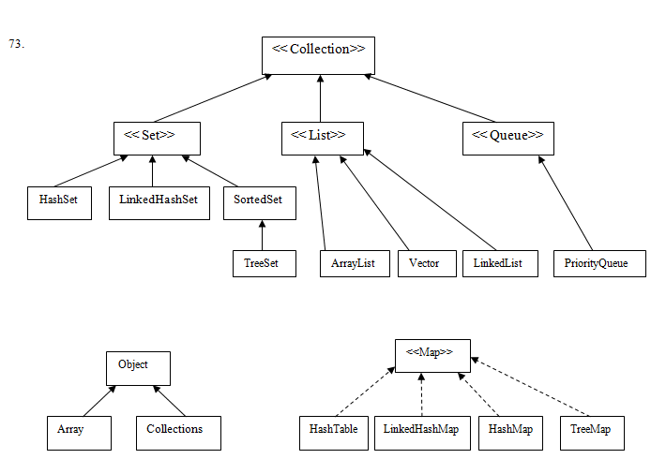
Collections Overview

Slide 3
Collections Overview
  Collection classes in Java are containers of Objects which by polymorphism can hold any class that derives from Object (which is actually, any class)
  Using Generics the Collection classes can be aware of the types they store

Slide 4
Collections Overview
Collection Comes in 4 basic flavors
Lists – Lists of things
Sets – Unique things
Maps – Things with a unique Id (Key – Value pair)
Queues – Things arranged by the order in which they are to be processed.
Ordered & Unordered Collections are – ArrayList
Linked HashSet – uses insertion so the last inserted element will be last element of the list - & ArrayList is opposite of this technique.
Hash table = Collection are unordered, although the HashTable itself has internal logic to determine the order (based on the hash Codes & implementation of the collection itself)

Slide 5
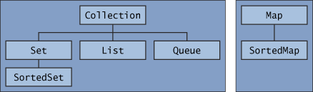
Which Collections do we have?
  There are two main interfaces for all the collection types in Java:
  – Collection<E>
  – Map<K,V>
  List of all Collections and related frameworks:
  http://java.sun.com/javase/6/docs/technotes/guides/collections/reference.html

Slide 6
Vector
  Vector is a synchronized dynamically growable array with efficient access by index
Example:
Vector<Integer> vec =
new Vector<Integer>(10/*initialCapacity*/);
vec.add(7);
initialCapacity is optional
Vector is an old (Java 1.0) container and is less in use today,
replaced mainly by ArrayList (Java 1.2) which is not synchronized

Slide 7
ArrayList
  ArrayList is a non-synchronized dynamically growable array with efficient access by index
Example:
ArrayList<Integer> arr =
new ArrayList<Integer>(10/*initialCapacity*/);
arr.add(7);
initialCapacity is optional
ArrayList is in fact not a list (though implementing the List interface)
If you need a list use the LinkedList class!
When performing many adds and removes
How should I know?

Slide 8
HashMap
  HashMap is a non-synchronized key-value Hashtable
Example 1:
HashMap<String, Person> id2Person;
...
Person p = id2Person.get("021212121");
if(p != null) {
System.out.println("found: " + p);
}
HashMap is a Java 1.2 class.
There is a similar Java 1.0 class called Hashtable which is synchronized and is less used today

Slide 9
HashMap
Example 2:
HashMap<String, Integer> frequency(String[] names) {
HashMap<String, Integer> frequency =
new HashMap<String, Integer>();
for(String name : names) {
Integer currentCount = frequency.get(name);
if(currentCount == null) {
currentCount = 0; // auto-boxing
}
frequency.put(name, ++currentCount);
}
return frequency;
}

Slide 10
HashMap
Example 2 (cont’):
public static void main(String[] args) {
System.out.println(
frequency(new String[]{
"Momo", "Momo", "Koko", "Noa", "Momo", "Koko"
}).toString());
}
Print out of this main is:
{Koko=2, Noa=1, Momo=3}
(
(
)
)
HashMap has a nice toString!
HashMap doesn’t guarantee any order!

Slide 11
HashMap
  For a class to properly serve as a key in HashMap the equals and hashCode methods should both be appropriately implemented
Example:
public class Person {
public String name;
boolean equals(Object o) {
return (o instanceof Person && ((Person)o).name.equals(name));
}
public int hashCode() {
return name.hashCode();
}
}
Parameter MUST be Object
(and NOT Person!)

Slide 12
Agenda
Collections Overview
Generics
Vector, ArrayList, HashMap
Utils
Special Collections
Exercise

Slide 13
Collection Utils
  Handful Collection utils appears as static methods
  of the class Collections:
  http://java.sun.com/javase/6/docs/api/java/util/Collections.html
  A similar set of utils for simple arrays appear in the class Arrays:
  http://java.sun.com/javase/6/docs/api/java/util/Arrays.html

Slide 14
Agenda
Collections Overview
Generics
Vector, ArrayList, HashMap
Utils
Special Collections
Exercise

Slide 15
Special Collections
BlockingQueue
  Interface, part of java.util.concurrent
  extends Queue with specific operations that:
    - wait for the queue to become non-empty when retrieving
    - wait for queue to have room when storing an element
ConcurrentMap
  part of the new java.util.concurrent
  extends Map with atomic putIfAbsent, remove and replace
CopyOnWriteArrayList
  As its name says…
For more Special Collections see the java.util.concurrent package:
http://java.sun.com/javase/6/docs/api/java/util/concurrent/package-summary.html

Slide 16
Agenda
Collections Overview
Generics
Vector, ArrayList, HashMap
Utils
Special Collections
Exercise

Slide 17
Exercise 1
Get Strings from the command line, present in the console a vertical bar chart of the frequency of each letter in the input.
  Treat small and capital letters the same -- as capital
  Ignore any char that is not an English letter
Example
For the following input: Hey how are you?
we expect the following chart:
A #
E ##
H ##
O ##
R #
Y ##
U #
W #

Slide 18
Exercise 2
Write the necessary classes to support the following main:
static public void main(String[] args) {
Expression e =
new Sum(
new Exponent( new Var("X"), new Number(3.0) ),
new Sum( new Var("X"), new Var("Y") )
);
Function f = new Function(e);
try {
f.setVar("Z", 3.0);
} catch(InvalidVariableException e) {
System.out.println(e.getMessage());
}
// the main continues in next page!

Slide 19
Exercise 2 – cont’
try {
f.evaluate();
} catch(MissingVariableException e) {
System.out.println(e.getMessage());
}
f.setVar("Y", 1.0);
for(double d=-1; d<=1; d+=0.5) {
f.setVar("X", d);
System.out.println("X=" + f.getVar("X") +
", Y=" + f.getVar("Y") + ", " + f + "=" + f.evaluate());
}
} // end of main
--- please continue to next page

Slide 20
Exercise 2 – cont’
--- the program above should print:
Variable ‘Z’ does not exist
Missing the following variable(s): ‘X’, ‘Y’
X=-1.0, Y=1.0, ((X ^ 3.0) + (X + Y)) = -1.0
X=-0.5, Y=1.0, ((X ^ 3.0) + (X + Y)) = 0.375
X=0, Y=1.0, ((X ^ 3.0) + (X + Y)) = 1.0
X=0.5, Y=1.0, ((X ^ 3.0) + (X + Y)) = 1.675
X=1.0, Y=1.0, ((X ^ 3.0) + (X + Y)) = 3

Slide 21
Hashing
Collection Uses
Indexing – List, Queues
Hashing- Set, Map
Why Hashing?
Searching is faster with Hashing
How do we compute Hashing?
It’s a integer value which can be denoted as
Int i=hash(object);
For example a string S=“ABC” the hash value can be
s.charAt(0)*31^{n-1 +} s.charAt(1)*31^{n-2} + ………. s.charAt(n-1)
“ABC”= ‘A’ *31² +’B’*31+’C’= 64578
‘Aa’ =2112
‘BB’=2112 Resulting same hashcode?---- Linear Probing Mechanism………. We increase the slot by k+1
Why do we override equals & Hashcode?
Answer is available in above discussion.
x.CompareTo(Y)==0 then X.equals(Y)==true, then X.hashCode()==Y.hashCode()

Slide 22
Set & Map
HashSet-→ LinkedHashSet→ Tree Set
HashSet-→ Unordered
LinkedHashSet-→ Ordered
TreeSet→ Sorted
The same is true for Map→ LinkedHashMap→ TreeMap

Slide 23
That concludes this chapter
amirk at mta ac il

